Slide 1
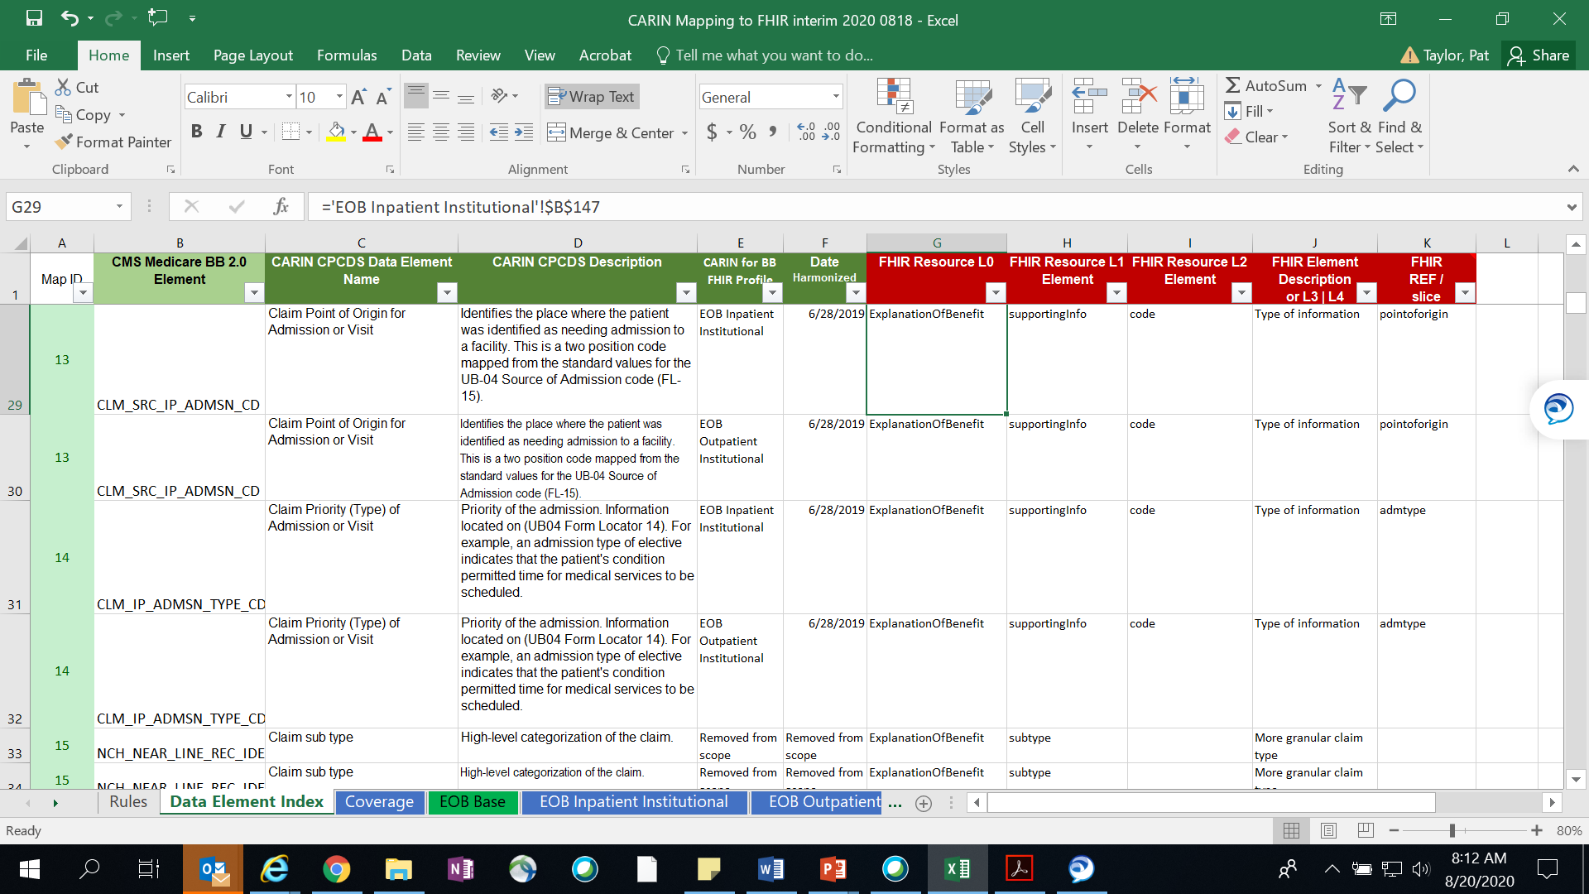
Mapping Worksheet | The Data Element Index maps CARIN CPCDS data elements to FHIR Resources; Each row maps to one of the profiles
CARIN for BB Profile
FHIR Resource Mapping
CARIN Data Elements
MapID
Cell Location in Profile Tab
Row 29
Profiles

Slide 2
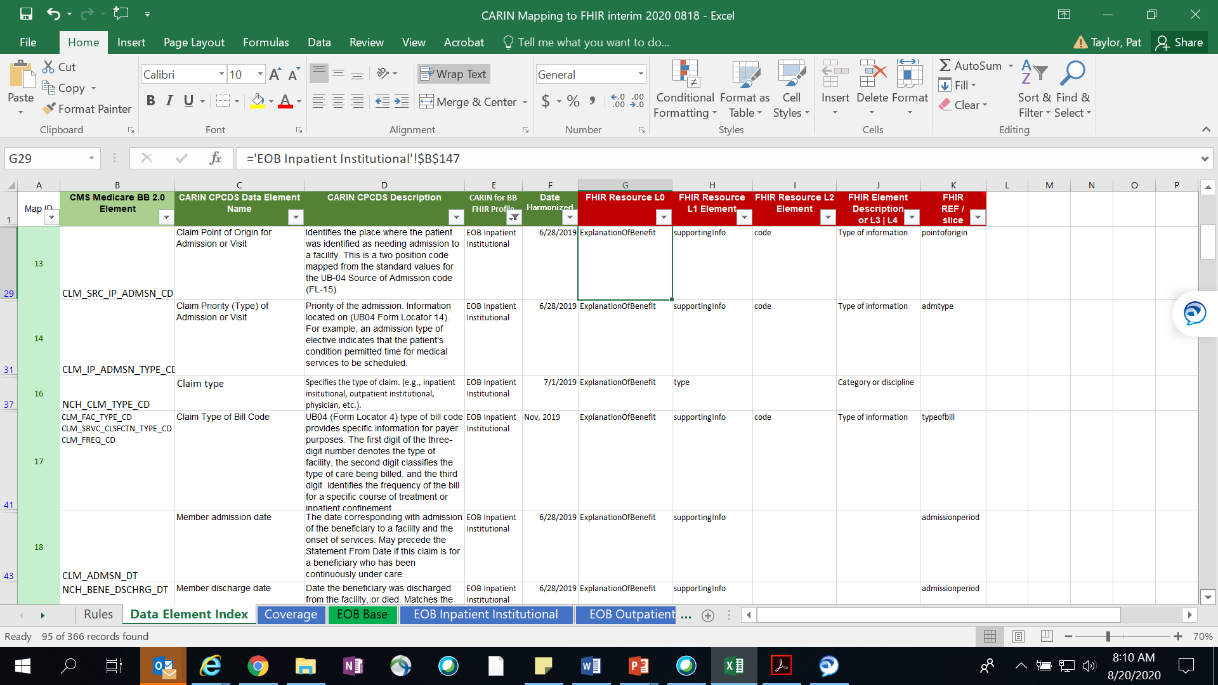
Mapping Worksheet | Many CPCDS data elements are not on all profiles. To identify the CPCDS data elements applicable to a specific Profile, payers may filter on the CARIN for BB FHIR Profile, column E, selecting the desired profile
Filter on EOB Inpatient Facility

Slide 3
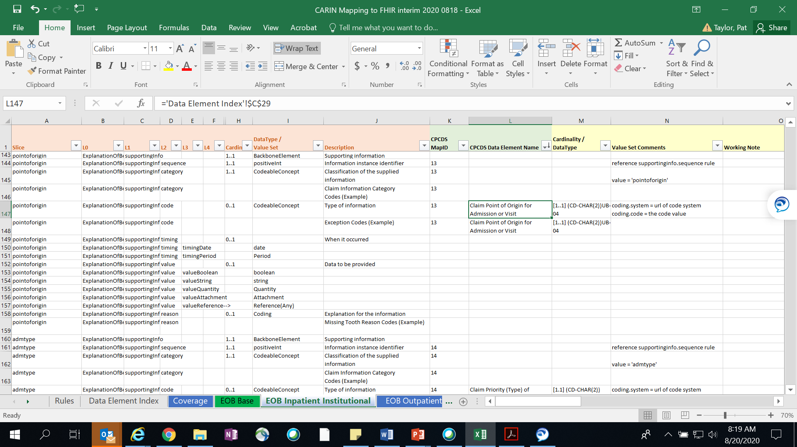
Mapping Worksheet | Each tab profile maps the CPCDS data elements to FHIR for each Profile. To map their data to CPCDS, payers may filter the MapID, column K, removing spaces and ‘removed from scope’
Cell location in Index tab
MapID
value sets.
defaults
CARIN for BB
FHIR EOB Resource
cardinality
Row 147
Profiles

